Slide 1

INSTRUCTIONS AND USER GUIDES/MANUALS
A SHORT INTRODUCTION

Slide 2
Key terms
INSTRUCTIONAL WRITING: A writing which gives instructions to readers regarding a well-defined and specific topic.
INSTRUCTIONS: Instructions direct/teach/guide a person to do something, furnish with information needed to accomplish something.
TASK: A specific piece of work, a distinct specific action/activity

Slide 3
Key terms
PROCEDURE: It refers to manner of proceeding; a way of performing or effecting something: standard procedure.

Slide 4
DEFINITION
A user guide or user's guide, also commonly known as a manual, is a technical communication document intended to give assistance to people using a particular system.
Manuals are written guides or reference materials which are used for training, assembling mechanisms, operating machinery or equipment, servicing products, or repairing products.
A user guide is essentially a book-length document containing instructions on installing, using, or troubleshooting a hardware or software product.

Slide 5
Ask yourself questions like:
What describes the user?
(What is their age, gender etc)
What tasks do they need to perform?
Why is the task being carried out?
How frequently will it be carried out?
In what environment will the product be used?
What language do they speak?

Slide 6
Is the user under stress?
What is their background? (awareness about the product/task)
Is the product used professionally, commercially or privately?
What technical experiences, qualifications, education, training, knowledge or skills do they have?
Does the user have access to the internet?

Slide 7
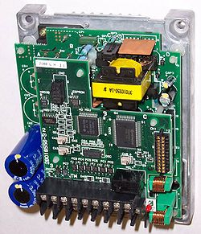
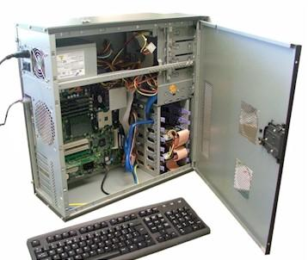

User guides are commonly associated with…..
Electronics goods
Computer hardware
Computer software

Slide 8
Components of a User Guide
Product description
Option/Function Explanations
The installation procedures
Precise Definitions (Optional)
Descriptions of mechanisms (Optional)
Step-by-step instructions of different TASKS
Analyses of processes (Optional)
Graphics
Headings

Slide 9
Components of a User Guide
Front and back covers
Title page
Edition notice
Trademarks and Disclaimers
Warranties
License agreements
Table of contents
Preface, Introduction, Product description
Getting started information
Installation procedure
Operating, maintenance, and trouble shooting instructions with safety notices
Appendixes
Glossary
Index
Reader-comment form

Slide 10
WRITING HEADINGS
Headings should be:
Descriptive and informative.
To the point and simple (SCOPE)
Use positive language.
Compare this;
Snow removal
With;
Using your xyz snow blower

Slide 11
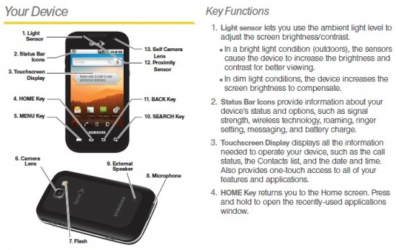
Examples

Slide 12
COMMON USES OF A MANUAL
To learn and understand how to operate something
To troubleshoot
To learn how to maintain something
To learn in detail the mechanisms and processes behind different functions

Slide 13
Steps in Manual Preparation
1- Conducting Audience Analysis
2- Determining manual type
3- Researching content and material
4- Deciding on manual production
5- Preparing the Graphics
6- Review the copy
7- Produce the manual

Slide 14

Step 1: Audience Analysis
1. Who will use the manual?
2. Are they novice users, intermediate level or advanced users?
3. Why do they need the guide?
4. To what extent do they require background details, definitions, explanation and analysis of mechanisms?
5. What is their competence in the language in which the manual will be written?

Slide 15
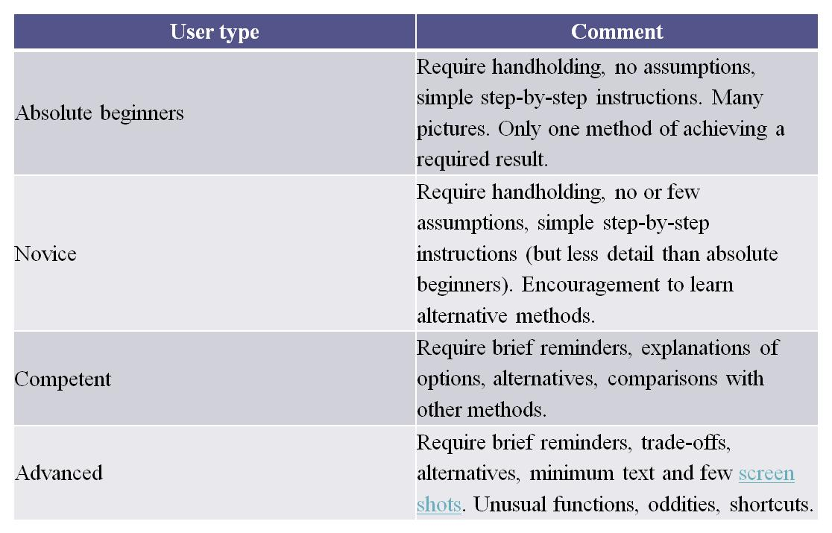

Slide 16
Considering these questions will help you develop an audience profile. Fill the form below after audience analysis.
Users: Age: Gender: Ethnic/Cultural/Educational Background: Level of technical knowledge/expertise in the field: Need for the manual: Suitable complexity level of the language, details, & the graphics: Suitable manual size and format: Appropriate style , expression, & presentations:

Slide 17

Remember!
Users usually read the documentation in desperation, after what they tried to do failed.
They're now frustrated, they have messed up things.
They're lost as to how to proceed to complete their goal.

Slide 18
STEP 2: Determining manual type
* Write down the type and purpose of the manual.
Consider:
Is the manual written for training people
for assisting people in performing specific tasks
for teaching laypersons all details regarding the operation and maintenance of a product, etc.

Slide 19
STEP 3: Researching content and material
Consult the engineering department to find out,
How the product works
What instructions and warnings must be stressed
Analysis and description of mechanisms and processes
Definitions of key terms
Prepare a working OUTLINE

Slide 20

In short,
TELL AUDIENCE
WHAT TO DO??
HOW TO DO??
WHY TO DO??
WHAT TO DO IN CASE OF PROBLEMS OR MALFUNCTION??

Slide 21
STEP 4: Deciding on manual production
Consider the following:
Appropriate presentation
How to provide the manual; for example, folded pamphlet or a booklet in product packaging
Decide on paper quality, print type, color usage, number of manuals, etc
Decide on any other accompanying material

Slide 22


STEP 5: Preparing the Graphics
Select suitable photographs, drawings, sketches, symbols, tables, etc.

Slide 23
STEP 6: Review the copy STEP 7: Produce the manual
Editing, proofreading, and revision is done at this stage. Finally, the manual is produced.

Slide 24
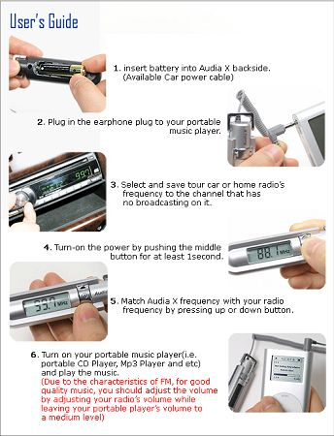
Writing Instructions

